Slide 1

SpiroConnect
integrated with
Occupational Health Management Software

Slide 2
With SpiroConnect connected to the computer and the required patient selected within OPAS-G2, the user loads the OPAS-G2 spirometry form.

Slide 3
The patient’s Height, Weight, Smoker Status and Ethnic Origin are entered. Any previously entered values for this patient are automatically used, but these can be updated.

Slide 4
The user clicks Start Test to launch SpiroConnect.

Slide 5
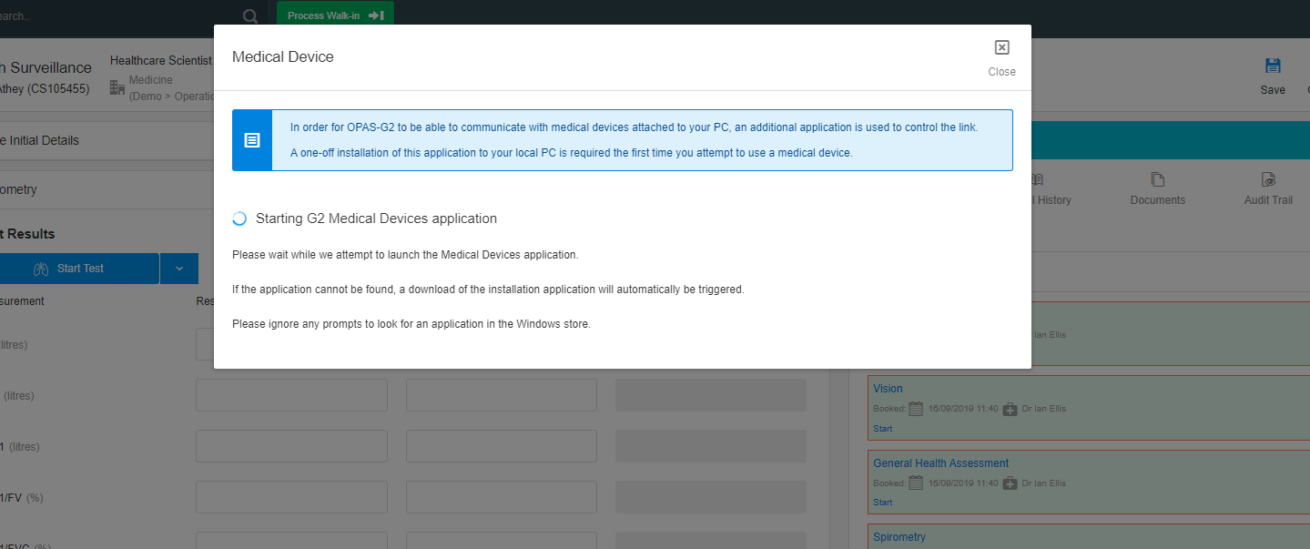
OPAS-G2 starts the Medical Devices Application.

Slide 6
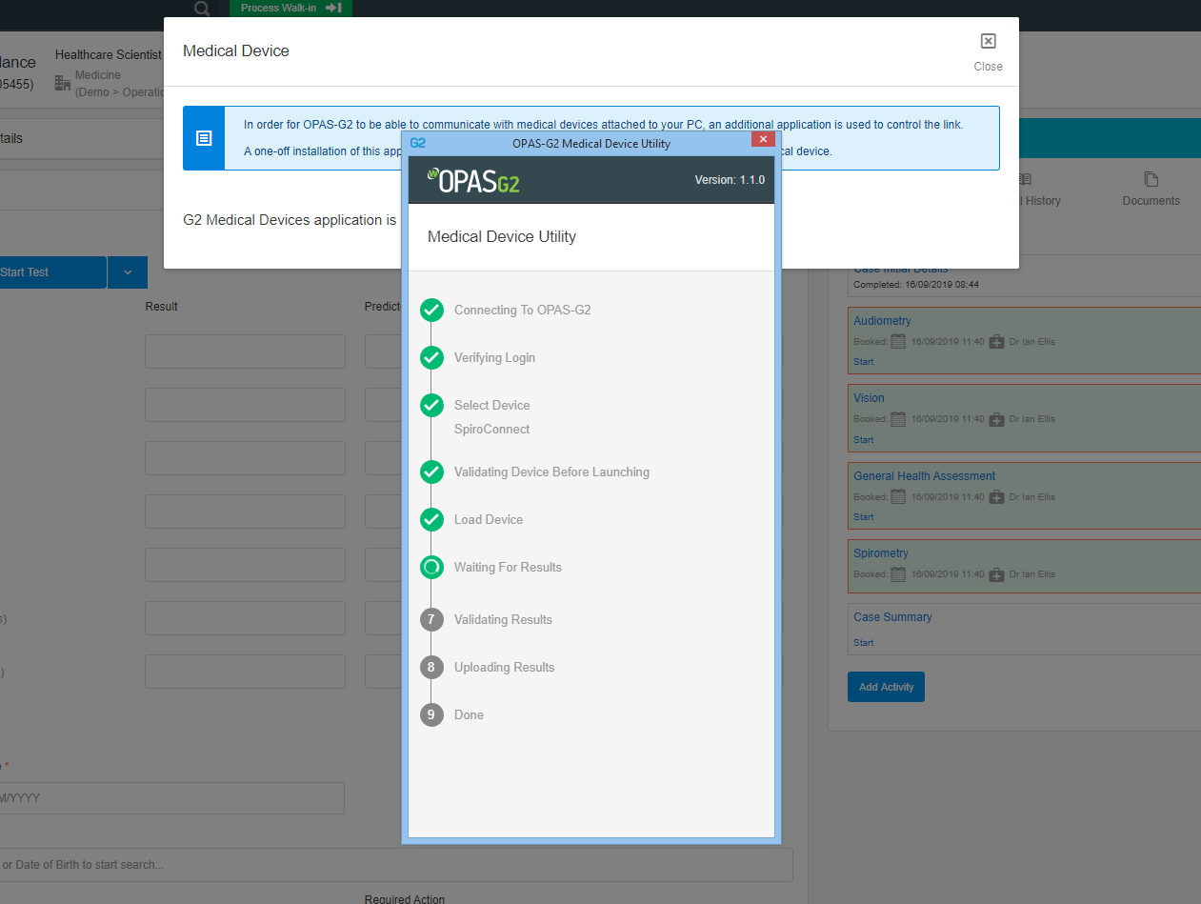
The OPAS-G2 Medical Devices Application opens, validates the SpiroConnect device, and launches the SpiroConnect application.

Slide 7
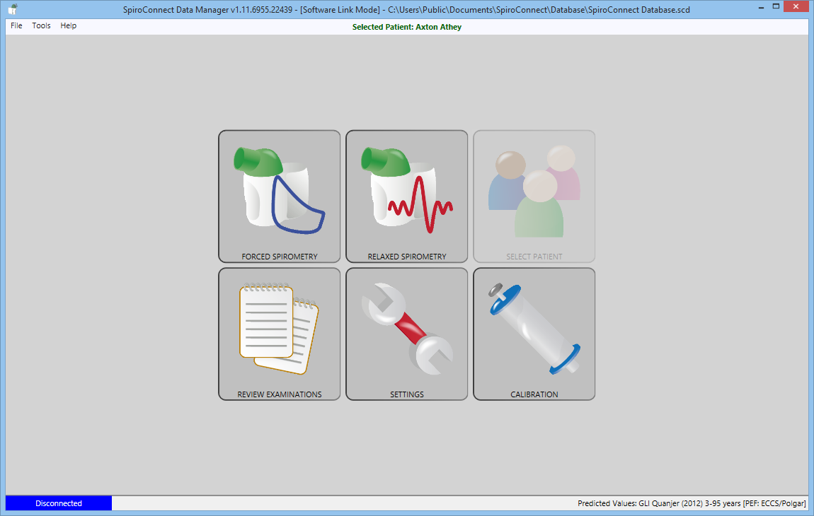
The SpiroConnect application is launched with the patient details automatically entered (passed from OPAS-G2).

Slide 8
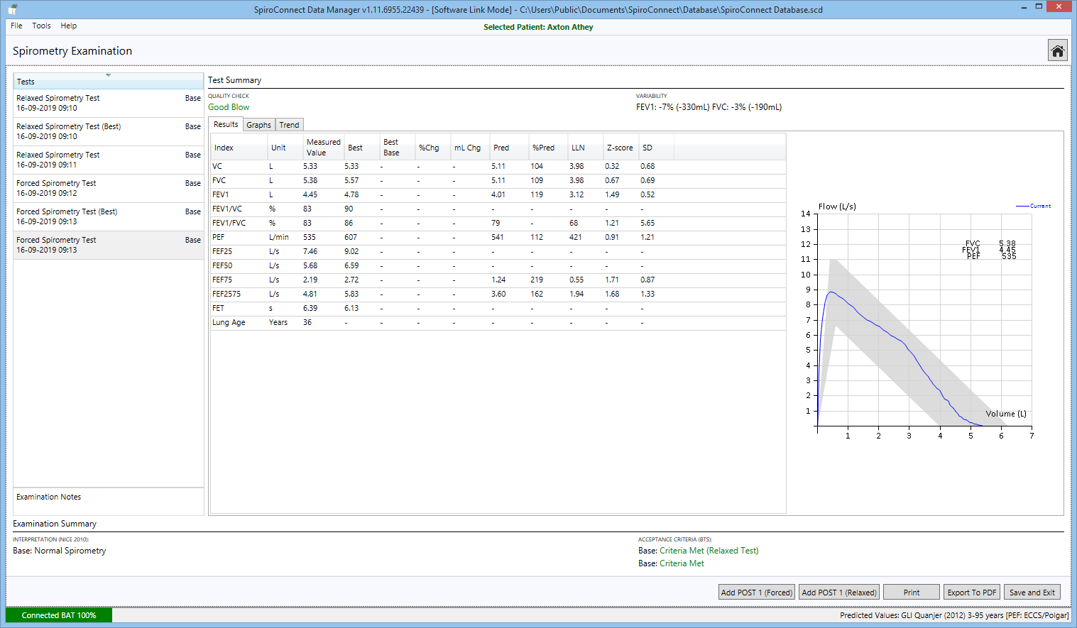
Once the SpiroConnect tests are completed, Save and Exit is selected.

Slide 9
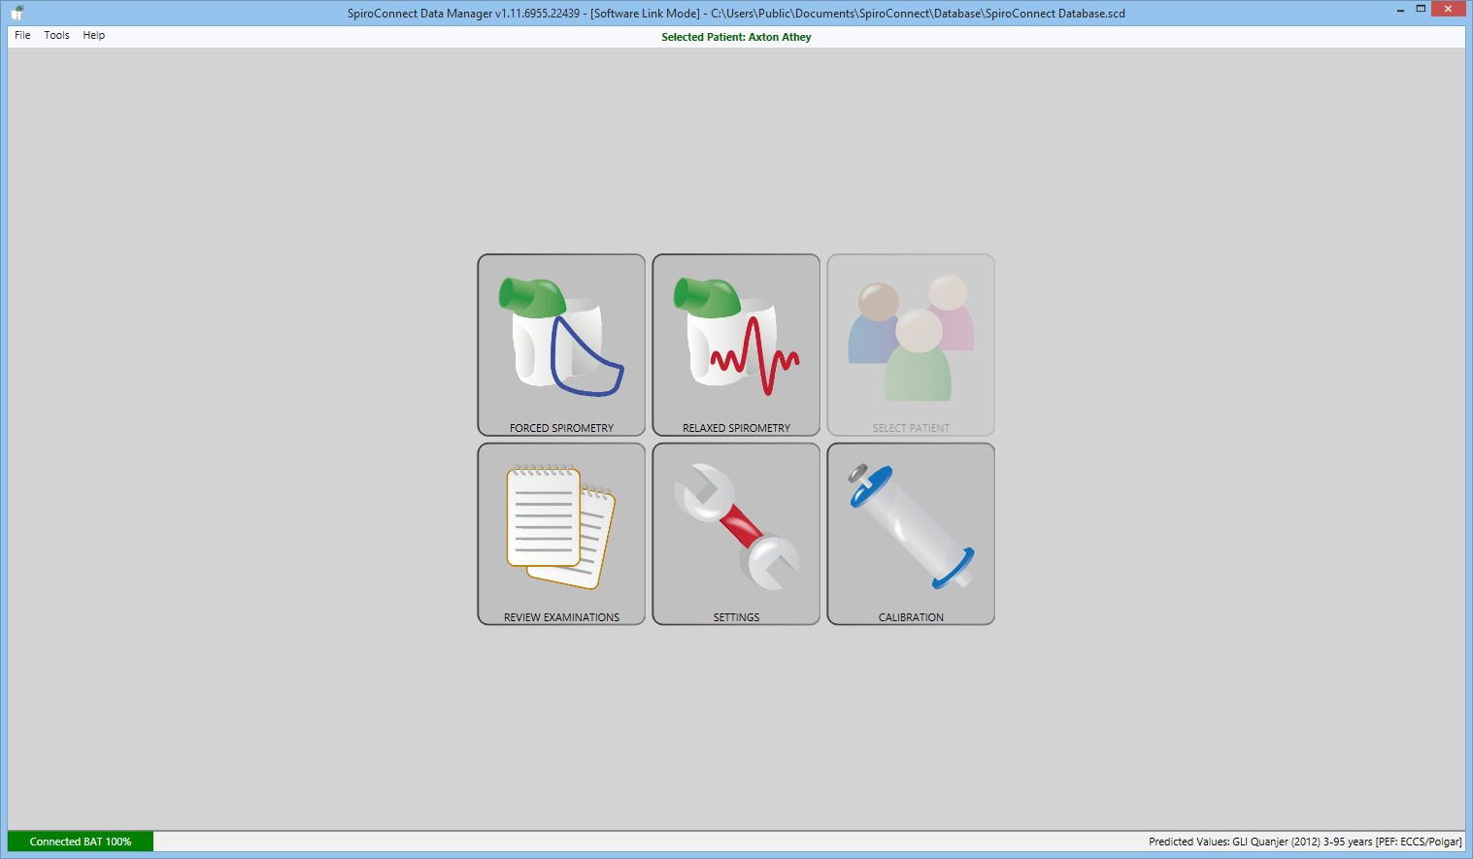
The user then closes down the SpiroConnect application…

Slide 10

…and the spirometry test is exported to the active OPAS-G2 patient record.

Slide 11
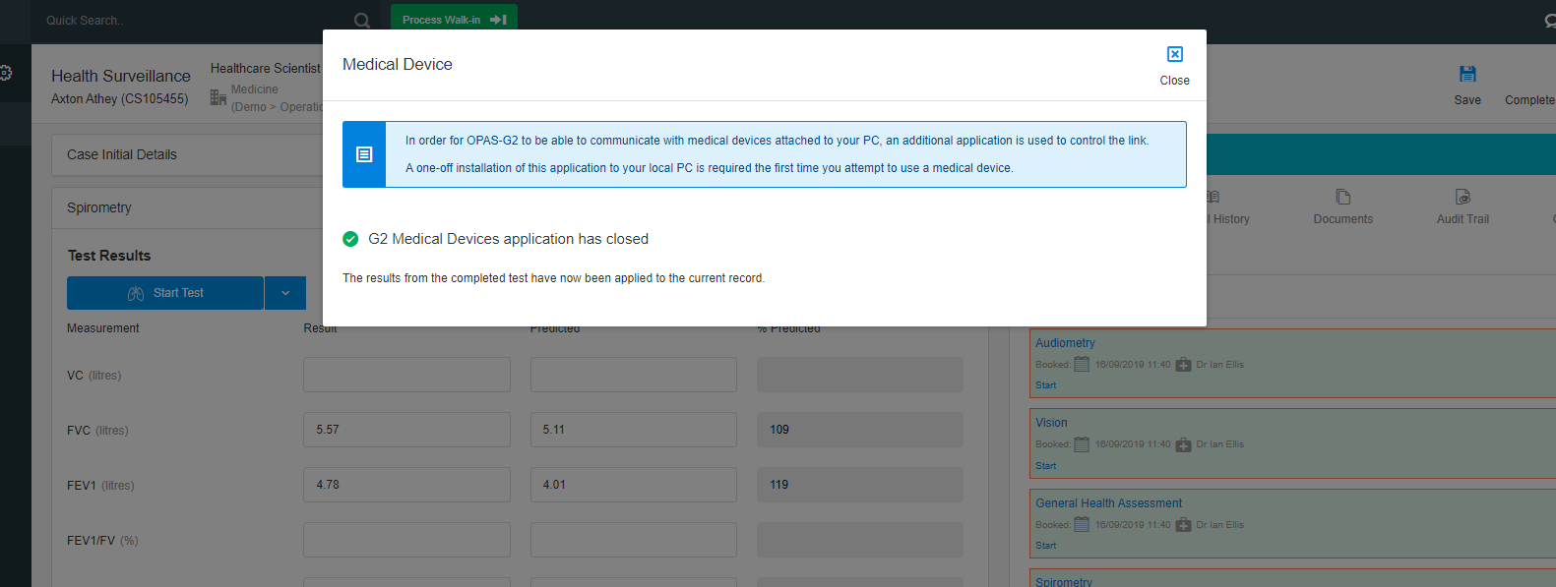
A message to inform the user that the results have been processed is displayed and the OPAS-G2 Medical Devices Application automatically closes.

Slide 12
The results are displayed within the OPAS-G2 Spirometry form.

Slide 13
Additional test information can be retrieved by clicking the Show additional test details link…

Slide 14
…such as Medical Device Used, Test Performed Date/Time, Interpretation, Lung Age etc

Slide 15
The full SpiroConnect report is also stored as a PDF in the Documents section of the spirometry test.

Slide 16
The SpiroConnect report can be previewed within OPAS-G2 or downloaded as a PDF file.

Slide 18
SpiroConnect
integrated with
Occupational Health Management Software

